Slide 1
Battle of Neighborhoods of Toronto
Data Science – Capstone Project

Slide 2


Introduction
Data analysis of two boroughs – Scarborough and North York in Toronto, Canada.
Objective is to explore the best neighborhood in Toronto and search for trending venues around a neighborhood using Data Science Tools
Both boroughs are segmented into neighborhoods to discover the top trending venues.

Slide 3
Data
https://en.wikipedia.org/wiki/Toronto
List of postal codes of Canada: M from Wikipedia
https://en.wikipedia.org/wiki/List_of_postal_codes_of_Canada:_M
Latitude and Longitude values are provided from a cvs file
https://cf-courses-data.s3.us.cloud-object-storage.appdomain.cloud/IBMDeveloperSkillsNetwork-DS0701EN-SkillsNetwork/labs_v1/Geospatial_Coordinates.cs
Foursquare API: Foursquare location data
https://api.foursquare.com/v2/venues/search?client_id={}&client_secret={}&ll={},{}&oauth_token={}&v={}&query={}&radius={}&limit
Toronto Information
https://en.wikipedia.org/wiki/Toronto

Slide 4
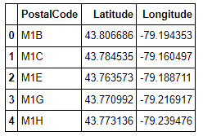
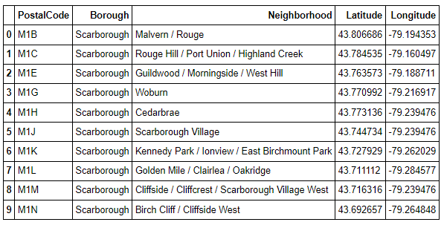
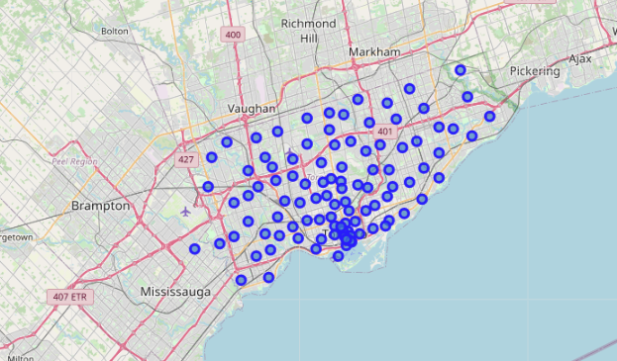
Methodology
Download and explore data set
Web scrapping: scraping the Wikipedia page using BeautifulSoup
Download csv file using wget command
Clean and wrangle data in a structural formatted data frame figure 1
Get coordinates using geopy library
Segment boroughs into neighborhoods figure 2
Map Toronto using folium
Figure 1
Figure 2

Slide 5
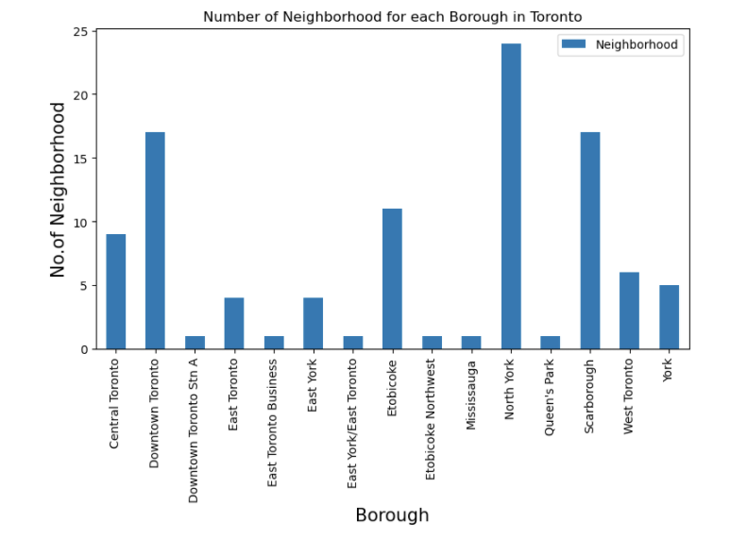
Methodology
Using matplot library to plot the boroughs with its neighborhoods on a bar graph.
North York: 23 neighborhoods
Scarborough: 17 neighborhoods
Downtown Toronto: 17 neighborhoods
Pick the top 3 boroughs – North York, Downtown Toronto, and Scarborough - according to their neighborhoods’ count - to segment

Slide 6
Methodolody
Define 2 functions
get_category_type(): extracts the category of the venues
getNearbyVenues(): extracts the nearby venues
Define Foursquare Credentials and Version
Utilize Foursquare data location for different purposes: make calls to Foursquare API to send a request to the API to explore a geographical location, to search for nearby venues, to explore a particular venue with its rating, and to get trending venues around a location.
LIMIT = 100 # limit of number of venues returned by Foursquare API
radius = 500 # define radius

Slide 7
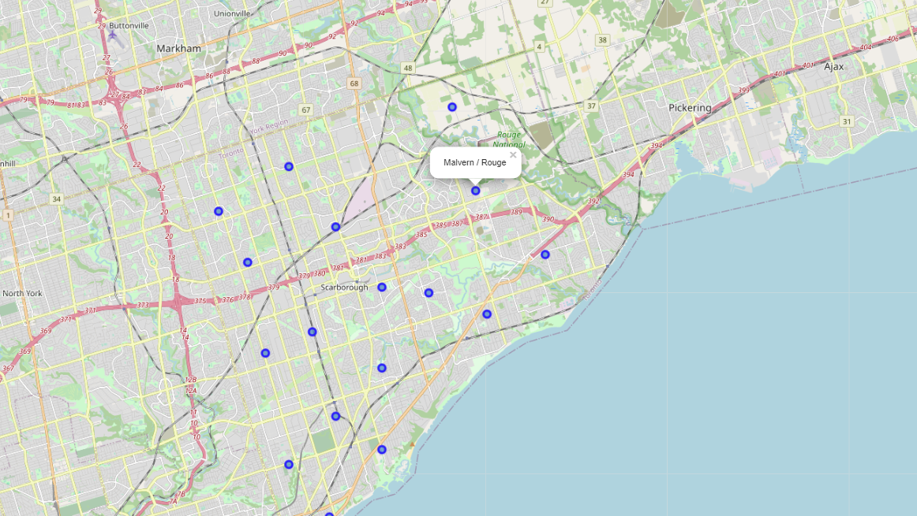
Methodology – Exploring scarborough
Create a new data frame of the Scarborough data.
Get the latitude and longitude coordinates of Scarborough using geopy library
Map Scarborough with 17 neighborhoods
Using get_category_type() and getNearbyVenues() to get venues and their categories
Filter and group venues into a list of unique venues returned by Foursquare
Analyze the neighborhoods to get the top common 10 venues using a machine learning algorithm called One hot coding
Explore the first neighborhood in Scarborough – Malvern/Rouge

Slide 8
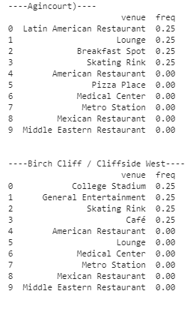
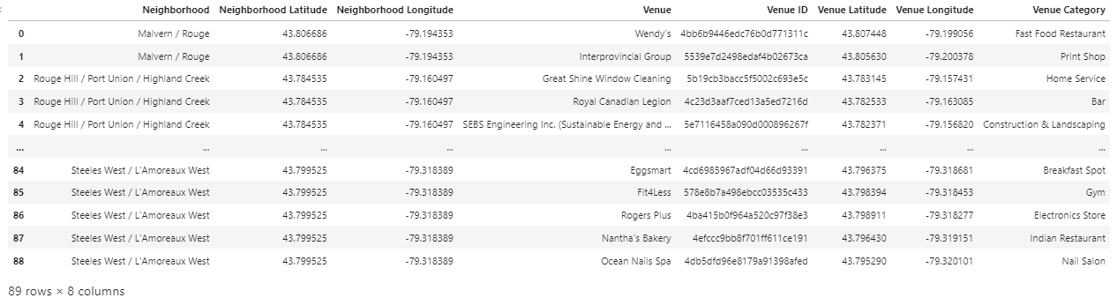
Methodology – Exploring scarborough
Top 10 trending venues in Agincourt, Scarborough
89 venues with 56 unique categories

Slide 9
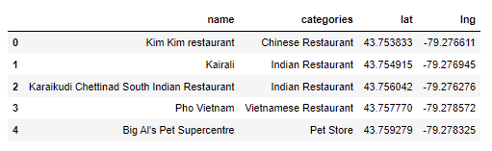
Methodology – Exploring 1st Neighborhood in scarborough
5 trending venues

Slide 10
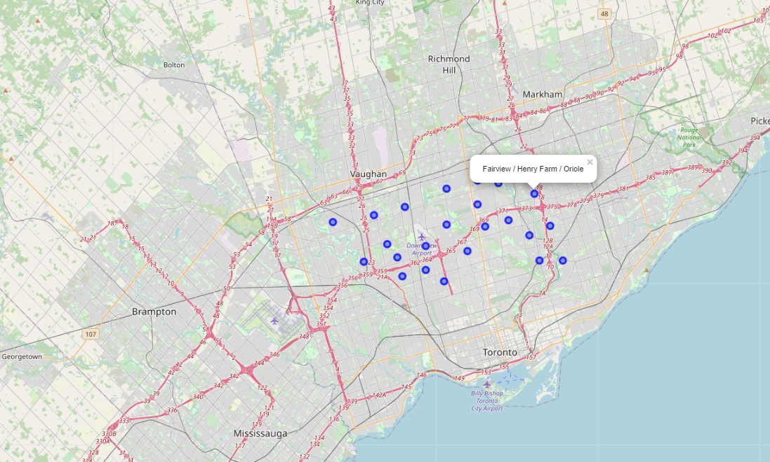
Methodology – exploring north york
Create a new dataframe of the North York data.
Get the latitude and longitude coordinates using geopy library
Map North York with 24 neighborhoods
Using get_category_type() and getNearbyVenues() to get venues and their categories
Filter and group venues into a list of unique venues returned by Foursquare
Analyze the neighborhoods to get the top common 10 venues using a machine learning algorithm called One hot coding
Explore the first neighborhood in North York – Fairview / Henry Farm / Oriole

Slide 11
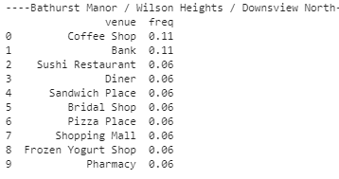
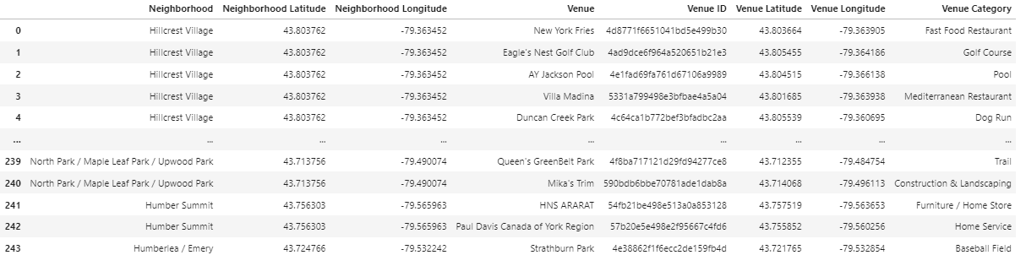
Methodology – Exploring North York
Top 10 trending venues
244 venues group into 101 unique categories

Slide 12
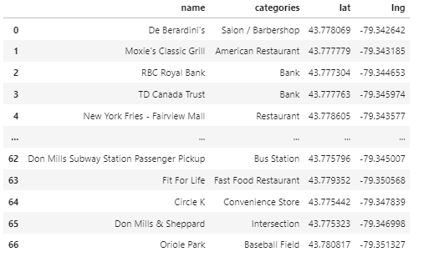
Methodology – Exploring 2nd neighborhood in North York
67 venues

Slide 13
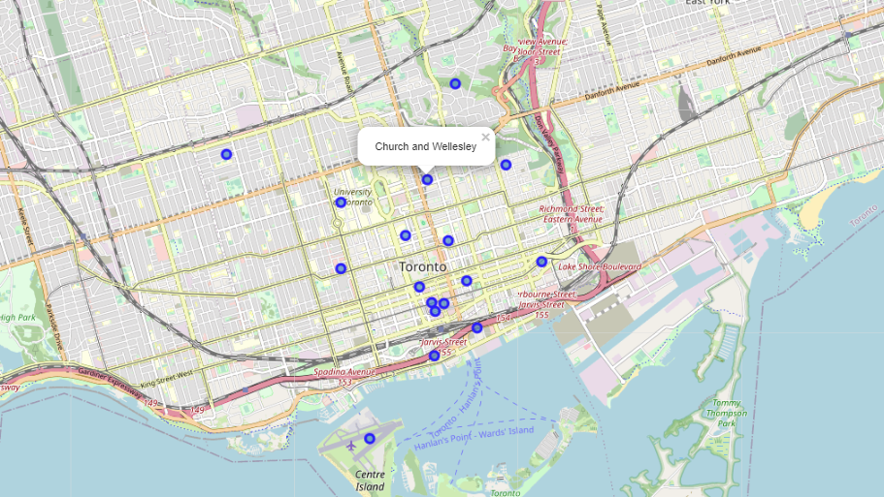
Methodology – Exploring Downtown Toronto
The same data analysis will be done for this borough but since North York encompasses most uptown Toronto will be using North York result for final comparison

Slide 14
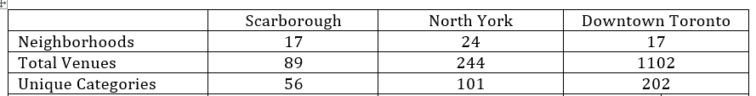
Results and Conclusion
North York has more and better selections in term of venues

